Slide 1
Capstone Project – The Battle of Neighbourhoods (Part-1)

Slide 2
1. Business Problem/Introduction
Choosing Best Location to start an Indian Restaurant in London:
For the success of any business, demand plays the most pivotal role and demand relies on the needs and wants of people. They look for expediency, ease and prompt availability; hence location is of utmost importance. Like any other factor, even demography has its own pros and cons- competition being one of them. To succeed, novelty plays a significant role. Creativity, thinking out of box to attract the masses and giving them world class service is the key to success. If we can identify the target audience, define the restaurant type, we’ll be well on our way to choosing a restaurant location that sets our business up for success. There’s a lot of work, planning and preparation that goes into opening a restaurant.

Slide 3
There are some steps that we need to take in order to achieve our goal of opening a restaurant in London:
Target market: In order to open a restaurant you need to be familiar with exactly who you are targeting to bring into our venue. What ethnicity people are you targeting? Also you need to aware of the age group, location, the amount of money they are willing to spend.
Restaurant Style: The first thing you need to decide is what type of restaurant you want to open and what style it will hold. What type of cuisine will you specialize in? What type of service will be providing to the customers? Will it be self-service or waiter-service? Do you want to open a casual cafe, or a fine-dining restaurant?
Create your Menu: Menu is the core of any restaurant. It’s important to get it right, as it is the deciding factors for customers voluntarily making a visit to your restaurant again. Your services could be impeccable, your premises may be exquisite, decor is amazing but without a good menu, you shall have no luck in success. Based on what ethnicity you are targeting, your menu should include those cuisines.

Slide 4
Competitors: Along with familiarising with the target customers, you must do so with your competitors. Look at the similar businesses in your area and well-renowned restaurants of the same category. Consider their marketing strategies along with the kind of services they provide. You need to be able to compete with these establishments, so take on board what they’re already doing and better it. Also, be aware of similar type of restaurants in the area you are looking to open, because if there is already lot of them, chances are you’re entering business in over-saturated area and the potential for you to succeed quickly may be diminished. So, consider opening in an area where there is a gap in the market and demand for your service. However you must also consider the negative like if there are no restaurants in the area similar to your theme, what’s the reason? It could be either it will not work or nobody has followed that path yet. So, before choosing the location for your restaurant this is important.

Slide 5
Interiors of Restaurant and locality: Some factors to keep in mind when finding premises for your restaurant:
How accessible is the location? How many competitors are there if any?
Make sure it is in the area of your target customer.
Cost is another factor. Your ideal location may prove to be little costly, so it is likely you will have to compromise on few things.

Slide 6
2. Data section
London is one of the most ethnically diverse cities in the world. At the 2017 census, London had a population of 8.9 million. Of this number, 44.9% are White British, 34% of the population were born outside the UK. We will focus on the Boroughs of London, for our restaurant problem and we will work on getting the data from all the Boroughs. There are 32 London boroughs with a population around 150,000 to 300,000. To find the best location to start an Indian Restaurant we consider parameters for which we need datasets:
a) Population of the target customers of London based on their:
Ethnicity
Age
Employment Status
Gender
Income
b)We also need the data for existing licensed restaurants in each Borough, considering our competition factor.

Slide 7
c) At last, we will consider the domestic annual spend estimates and also the tourist levels.
All the above required information is available at London Data store, which is an open data-sharing portal and is free also. In this portal anyone can access the information relating to the city. The data that is available in the Data store is in CSV and XLS format.
The link for the London Data Store - https://data.london.gov.uk/
How the data will be used to solve the problem:
The data will be used as follows: Using Foursquare and geopy data to map the locations/ neighbourhoods and clustered in groups. Use foursquare and geopy data to map the location with the highest population of Asian communities and then identify the venues near that.

Slide 8
Methodology Section:
This section represents the main component of the report where the data is gathered, prepared for analysis. The tools described are used here and the Notebook cells indicate the execution of steps.
The processing of these Data and its mapping will allow answering the key questions to make a decision:
What ethnicity people are we targeting?
What age group people we are focusing on more?
What type of cuisine will you specialize in?
What type of service will be providing to the customers?
Will it be self-service or waiter-service? Do you want to open a casual cafe, or a fine-dining restaurant?
However you must also consider the negative like if there are no restaurants in the area similar to your theme, what’s the reason?
How accessible is the location?

Slide 9
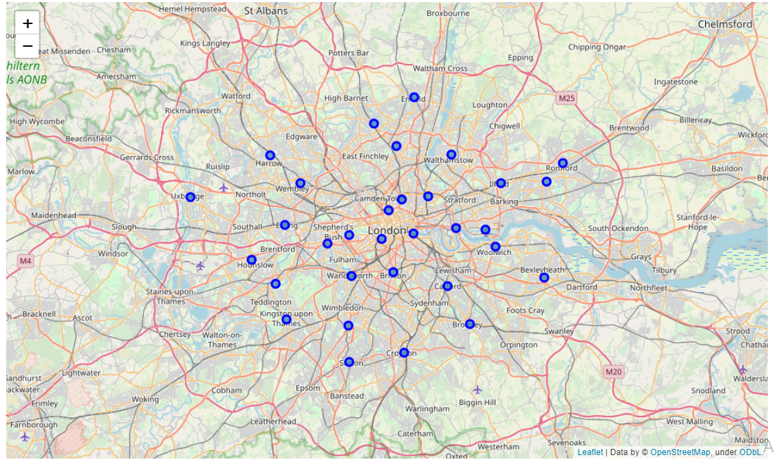
We will start by mapping the data and reading the latitude and longitude coordinates of all boroughs in London from a Wikipedia link. Then we get the latitude and longitude of London city using geopy library. The geographical coordinate of London City are 51.5073219, -0.1276474.

Slide 10
Preferred Location for Indian Restaurant
Based on the target audience we choose the location. For Indian Restaurant, we are focusing on ethnicities like India, Pakistan, China, Bhutan, Nepal and Srilanka. So basically we are focusing on Asian people. As the borough Newham is having high Asian population, we will consider to Segment and Cluster only the neighbourhoods of this borough. For that we have to get the latitude and longitude details of all the neighbourhoods of Newham borough. Then we created a dataframe from the areas list for the location Newham:

Slide 11
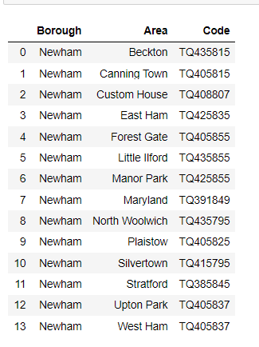
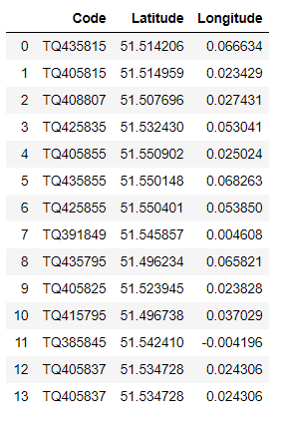

Slide 12
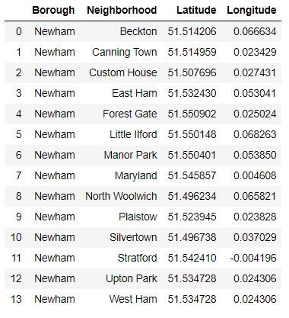
After that we merge the neighbourhoods and Geocode dataframes and then we change the name of the column ‘Area’ to ‘Neighbourhood’

Slide 13
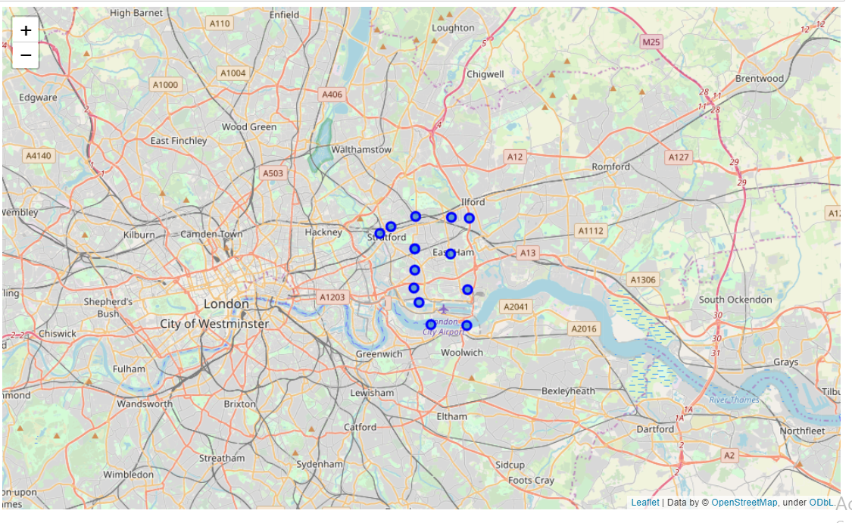
Now let’s visualize the Neighbourhoods of Newham Borough:

Slide 14
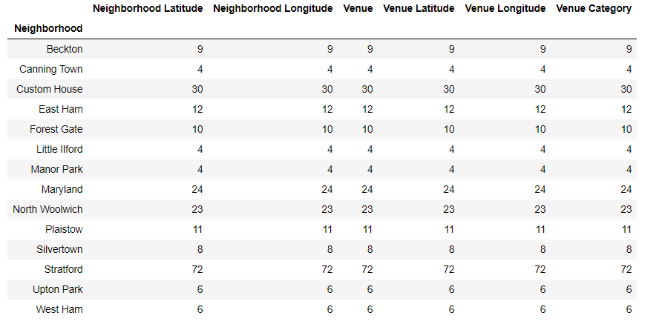
We now write the code to sun the above function on each neighbourhood and create a new dataframe called Newham venues and we check how many venues were returned for each neighbourhood:

Slide 15
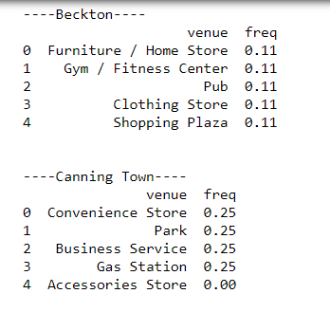
After that we print each neighbourhood along with the top 5 most common venues:

Slide 16
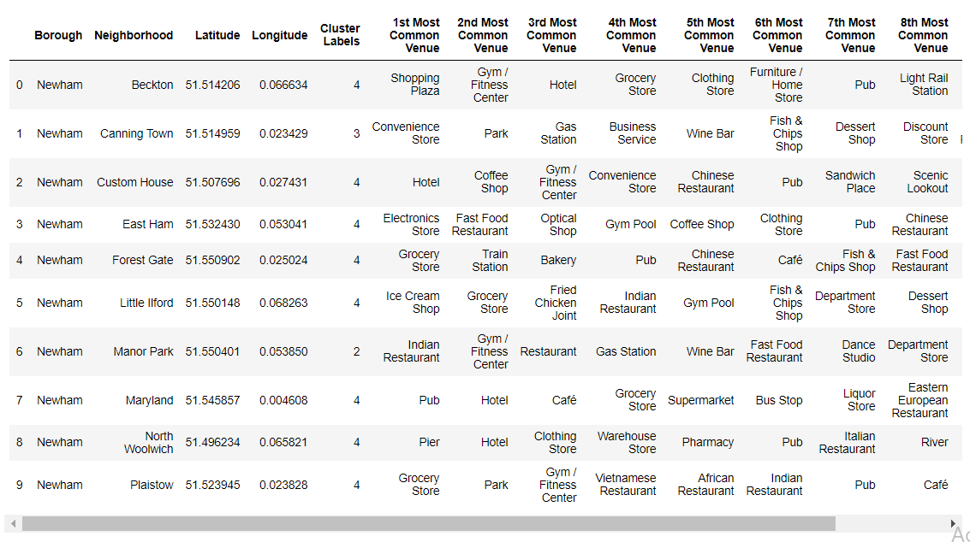
4. Result

Slide 17
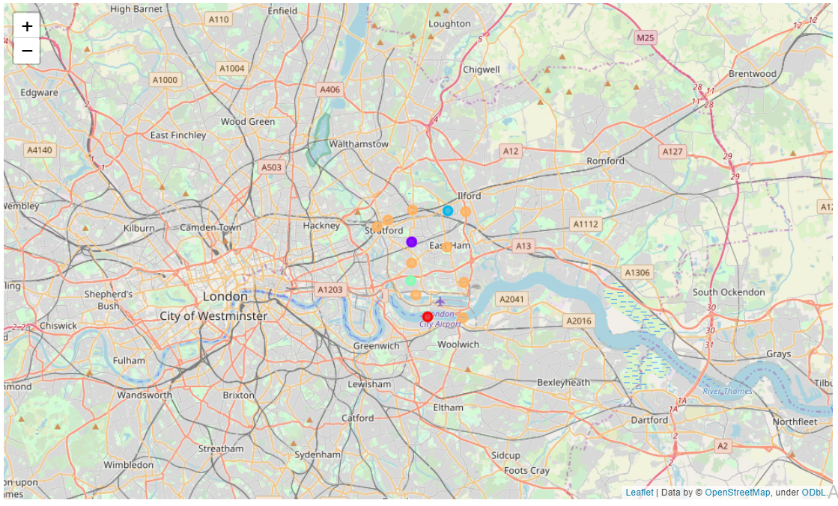

Slide 18
After examining the cluster we can recommend that Beckton, Custom House, Maryland, Eastham and Manor Park are the best neighborhoods in Newham borough, to open the Indian restaurant. This is because in these areas, the most common venue visited by the public is the restaurants and as these areas are highly populated with people from Asian countries, opening an Indian Restaurant would definitely be a good idea.

Slide 19
5. Discussion
I feel this capstone project presented me a good opportunity to practice and apply the Data Science tools and methodologies learned.
In general this course help me learn skills and acquire a good starting point to become a professional Data scientist, also the overall organization, content and lab works presented during the course are positively good

Slide 20
6. Conclusion
This project has shown me practical application to resolve real situation that has impacting personal and financial impact using Data Science tools.
I have created a good project that I can present an example to show my potential.
I feel rewarded with the efforts, time and money spent. This covers all the topics basics which is good as a starting point to learn big things.

